Slide 1


HR Analytics Dashboard Report
This presentation outlines the key findings and recommendations from an HR analytics dashboard project, designed to optimize workforce management using Power BI.
by Swapnil Mondal

Slide 2
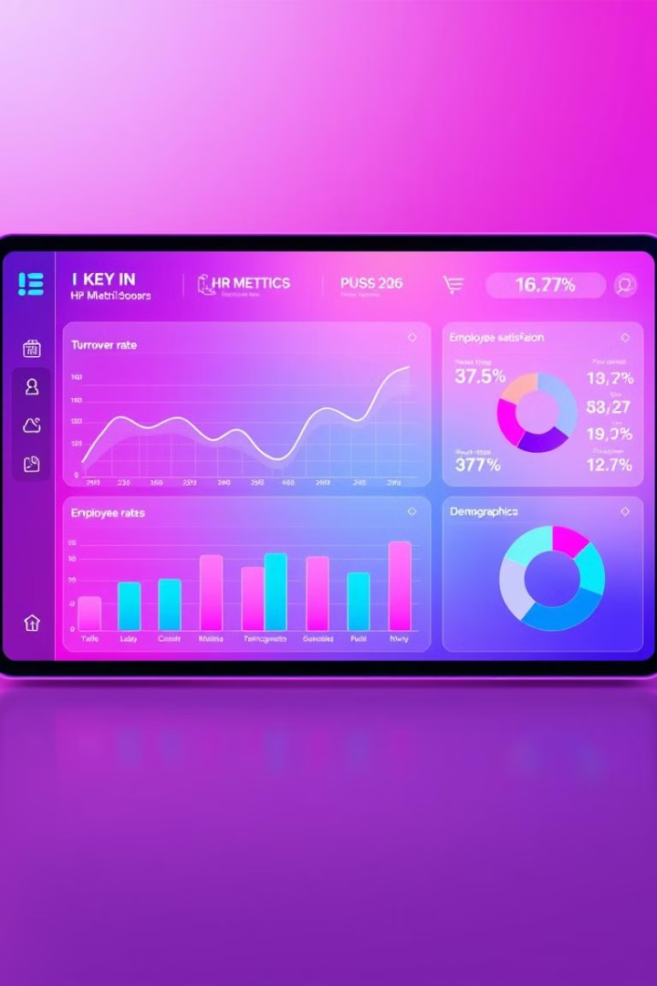
Project Objectives
Attrition Analysis
Demographic Insights
Identify trends and drivers behind employee turnover.
Analyze workforce composition by age, gender, and education.
Satisfaction Metrics
Dashboard Development
Quantify and visualize job satisfaction by role and department.
Build a dynamic Power BI dashboard for real-time data visualization and decision-making.

Slide 3
Tools and Technologies Used
Power BI
Data Sources
Data Loading
Employee demographic data
Data Modeling
Performance and job satisfaction data
DAX Formulas
Attrition status and departmental information
Visualizations

Slide 4
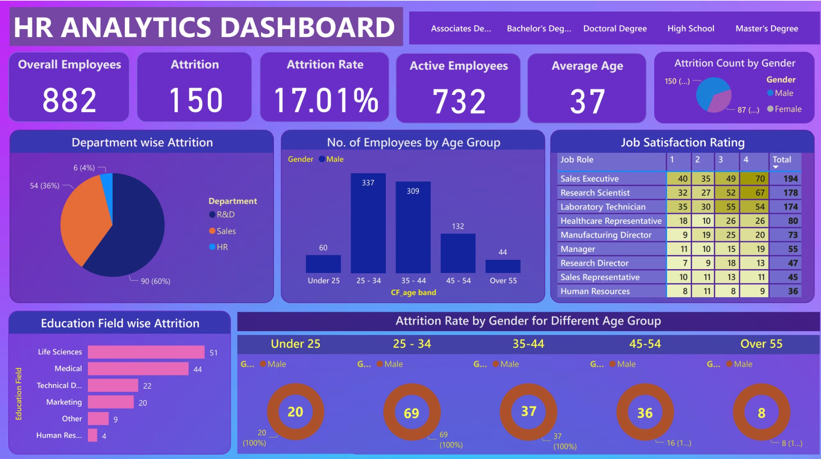
Project Objectives
Attrition Analysis
Demographic Insights
Satisfaction Metrics
Dashboard Development
Identify trends and drivers behind employee turnover.
Analyze workforce composition by age, gender, and education.
Quantify and visualize job satisfaction by role and department.
Build a dynamic Power BI dashboard for real-time data visualization and decision-making.

Slide 5
Key Findings and Insights
Attrition Trends
Demographics Impact
The Sales department has the highest attrition rate (60%), followed by R&D (36%) and HR (4%). Female employees have a higher attrition rate compared to males.
The majority of employees fall in the 25–34 age group. Employees with Life Sciences and Medical educational backgrounds report the highest attrition. The average age of employees is 37 years.

Slide 6
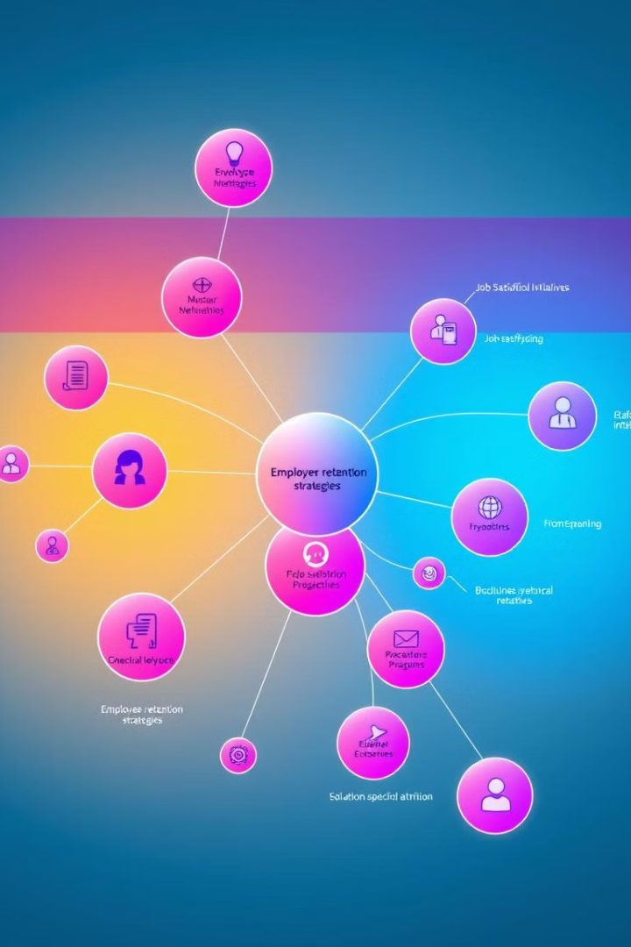
Recommendations for Improvement
Improve Retention Strategies
Focus on Job Satisfaction
Conduct periodic surveys to understand dissatisfaction drivers in HR and Sales roles. Introduce employee recognition programs to improve morale.
Provide targeted incentives and career growth opportunities for employees in Sales and R&D. Offer flexible work policies and mentorship programs for female employees.
Address Education-Specific Attrition
Strengthen Gender Equity
Implement policies to ensure gender equity in promotions and rewards.
Offer tailored training and development programs for employees from Life Sciences and Medical backgrounds.

Slide 7
Technical Methodology
Data Cleaning
1
Handled missing data using replacement strategies. Transformed textual data into categorical formats for easier aggregation. Standardized date and numeric fields for compatibility.
Data Modeling
2
Built relationships between datasets using common keys. Applied Star Schema methodology to optimize query performance.
Dashboard Design
3
Implemented slicers for filtering data. Created custom calculated fields for attrition rate and satisfaction index. Used various visualizations for intuitive data representation.

Slide 8

Conclusion and Next Steps
The HR Analytics Dashboard effectively visualizes crucial employee metrics, offering valuable insights into workforce demographics, attrition patterns, and job satisfaction. This project demonstrates the potential of data analytics in guiding HR policies and improving organizational efficiency.
The deliverables include an interactive dashboard and a GitHub repository documenting the workflows, ensuring scalability and reproducibility for future analysis.

